Slide 1
An Improvement of
“An Iterative Mean Filter
for Image Denoising”
U. Erkan, D. N. H. Thanh, L. M. Hieu, and S. Engínoğlu,
“An Iterative Mean Filter for Image Denoising,” in IEEE Access, vol. 7, pp. 167847–167859, 2019.
Panaj Abhavudhichai 6471037521
2102676 Digital Image Processing 2021/2

Slide 2
Introduction
Image denoising process is essential pre-processing task for the accuracy and performance improvement in the post-processing tasks such as object segmentation, feature extraction, object recognition, and image classification
Common methods for removing Salt-and-pepper noise (SPN) are the median-based (Median Filter, Adaptive Median Filter, and a lot of its variants), total variation-based, deep learning-based methods, etc.
Iterative Mean Filter (2019) was proposed to overcomes the drawbacks of using adaptive window (increases the computational complexity and reduces the accuracy of the filter) and fixed window (poor performance in medium to high-density SPN removal) by using only 3x3 fixed window but combined with iterative process to achieve low complexity and effective in high-density SPN
After some experiments, the modified version can outperform the original Iterative Mean Filter in the quality assessment metrics sense (by exploiting the Minkowski distance and replace the mean with weighted mean instead)

Slide 3
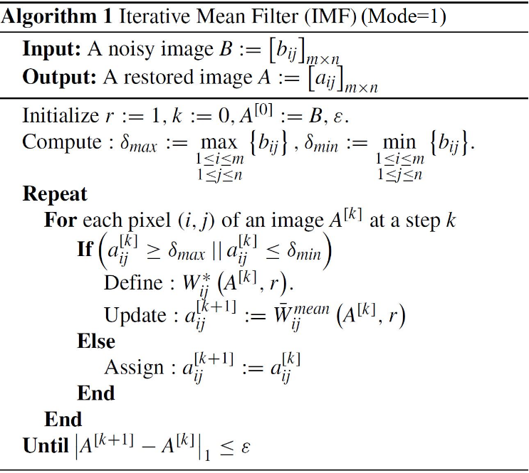
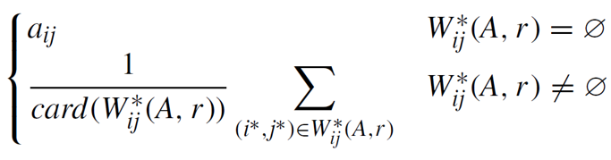
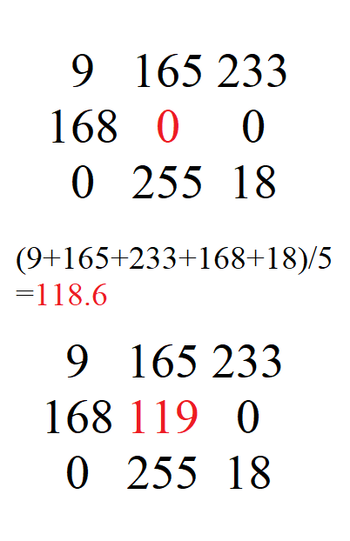
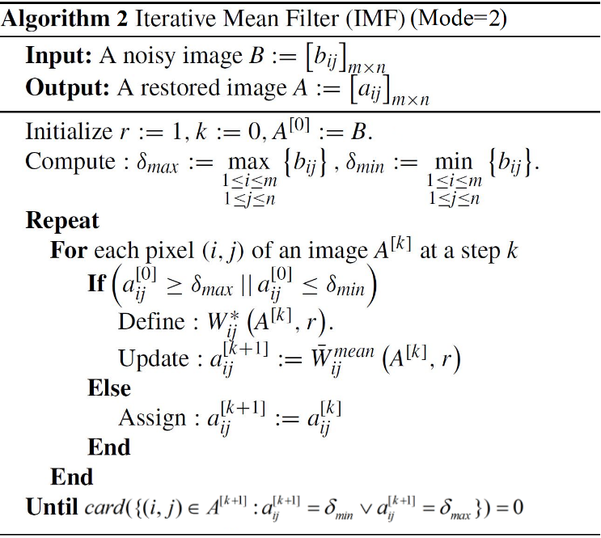
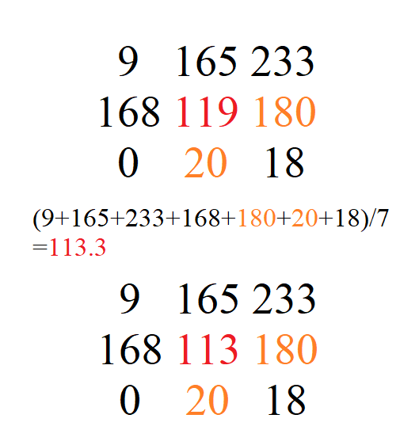
Iterative Mean Filter (IMF)
For 8-bit grayscale images (works only natural images but failed on synthetic images that has too much informative pixels with 0 or 255 value – many other algorithms also failed)
Consider maximum/minimum intensity in the noisy image as SPN then process each noisy pixel using sliding window (and replicate padding) iteration by iteration until stopping criterion reached
If the current center pixel is noisy and there are some noise-free pixels (intensity ≠ 0 or 255), update it with constrained mean, otherwise, remain the old intensity value from last iteration
The authors also released IMF program (after the paper was published) as the execute-only MATLAB p-code file (they did not reveal their source code) and it’s different from Algorithm1
After trial and error, Algorithm2 can performed exact results as the author’s program. It’ll stop when there are no noisy pixels left instead of Sum of Absolute Differences: SAD criterion, and it keeps repeat the constrained mean on each denoised position at every iteration – always treat noisy pixels from the first iteration as noisy pixel positions even it’s updated, while Algorithm1 only do once

Slide 4
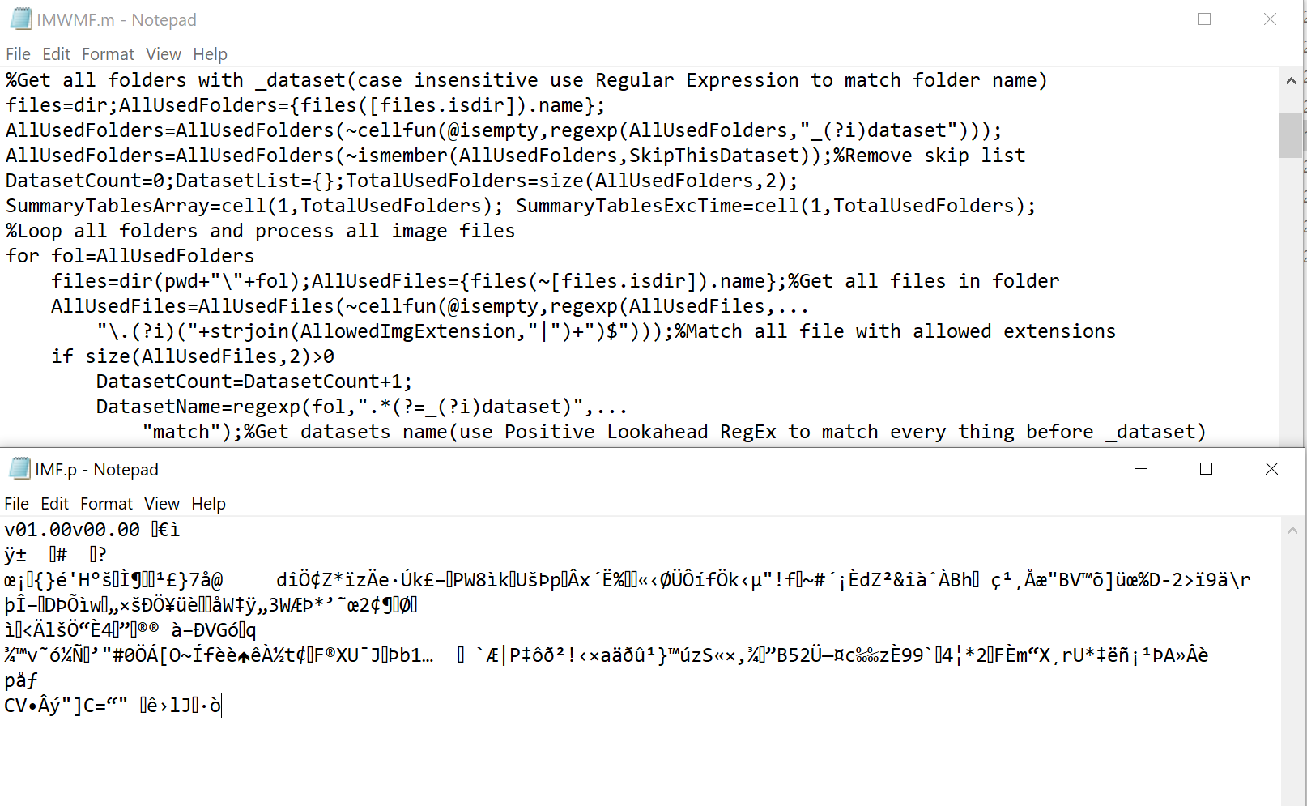
Released IMF program as the obfuscated MATLAB P-code file (execute-only)

Slide 5
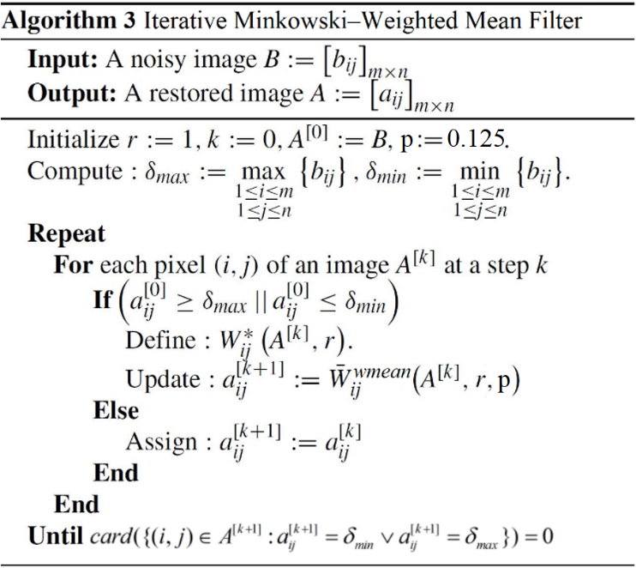
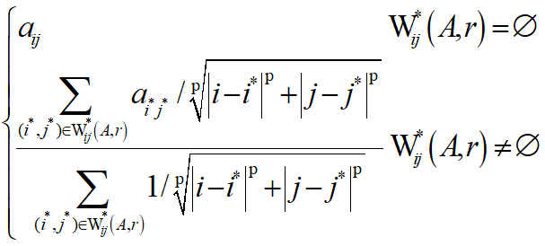
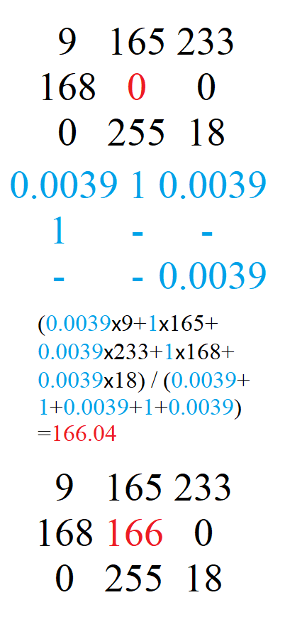
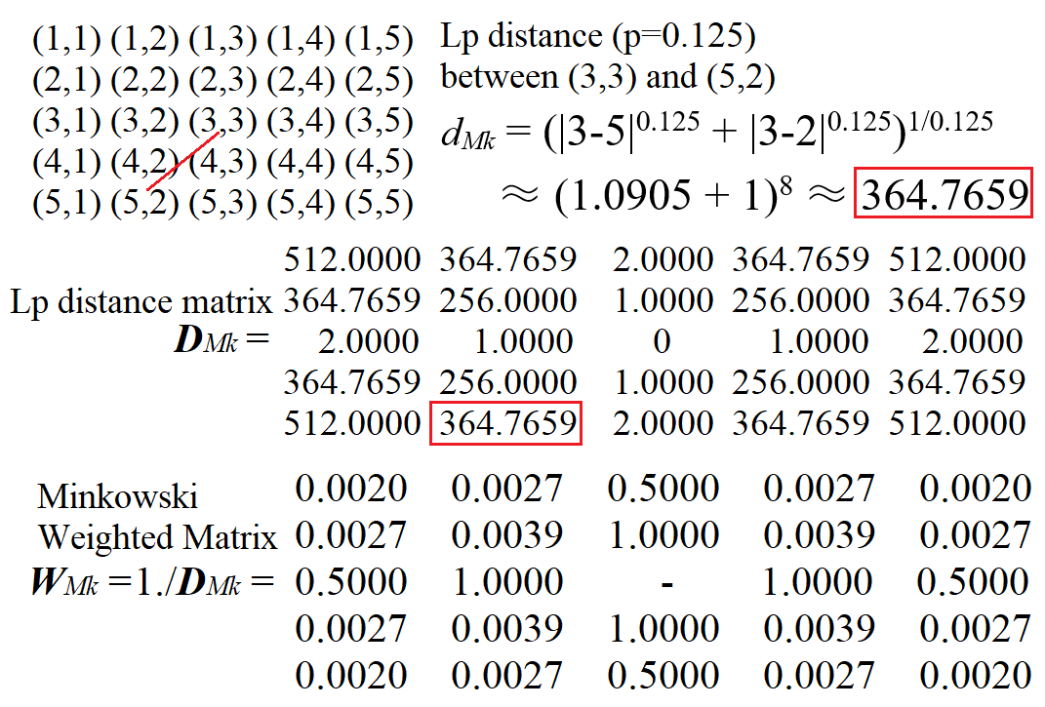




Improved Method (Proposed IMWMF)
Based on IMF (Mode=2), only different is it uses constrained Minkowski weighted mean instead of constrained mean.
The pixels that are closer distance to the center pixel have more relationships than the farther pixels and should have more importance when taking into consideration
The weights are based on Minkowski distance (p=0.125) from the coordinate of center pixel to the destination (the more distance, the less weight)
Use the Minkowski distance because it’s simple, adjustable p parameter, and it’s generalized form that can be changed into the renowned distances i.e., Chebyshev (p→∞), Euclidean (p=2), and Manhattan (p=1). There are other distance families that could also apply to this (maybe the future study)
p=0.0625,0.125,0.25,0.5,1,2 were used, p=0.125 yields the best

Slide 6
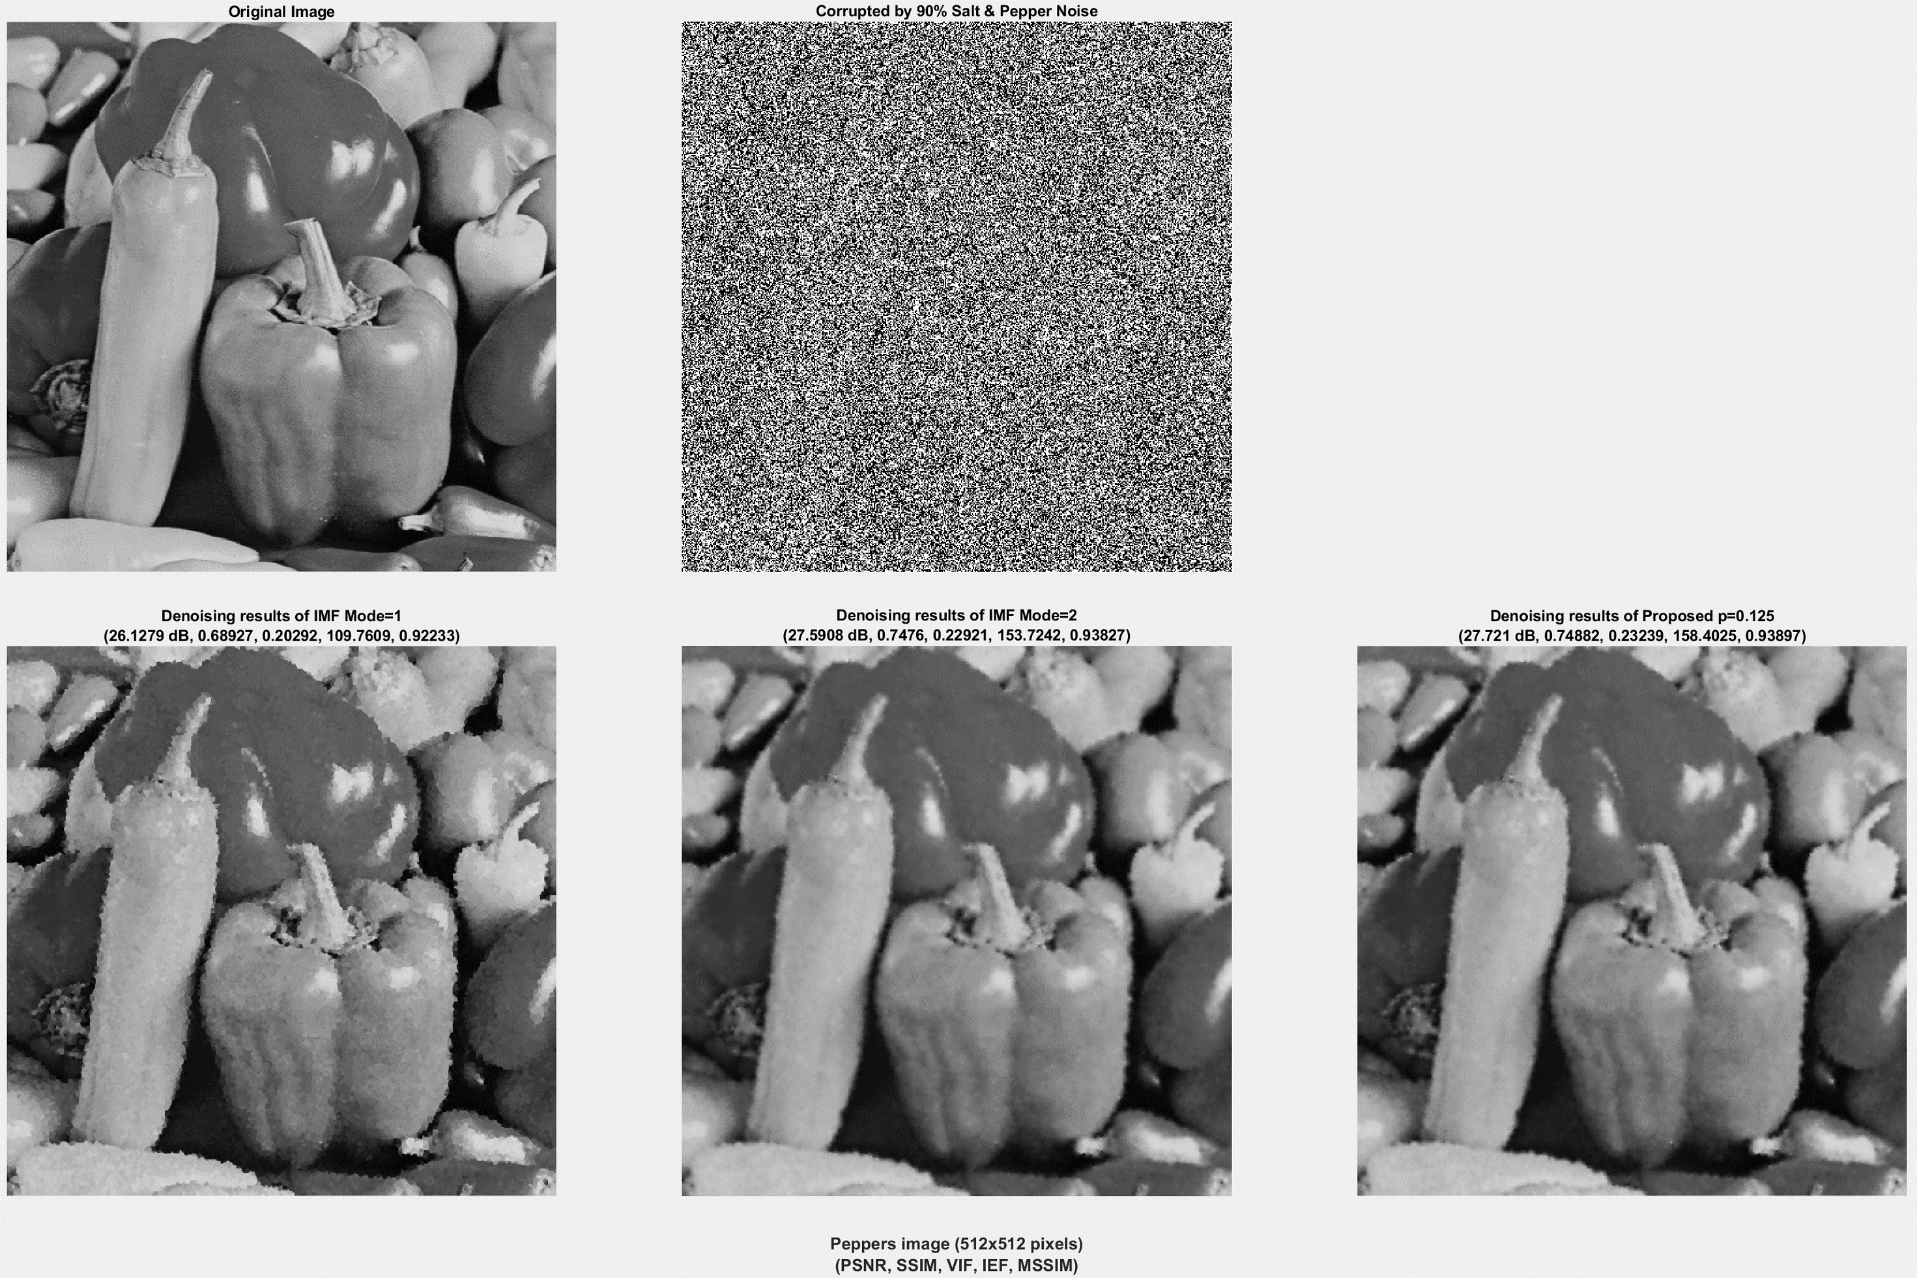
Experimental Results & Discussion
Use the same setting as in original paper, apply the filters on 3 image datasets (traditional, TESTIMAGES, and BSDS) with SPN 10%-90%
Image quality assessment metrics are PSNR, SSIM, VIF, IEF, and MSSIM
For high-density SPN, IMF (Mode=1) looks sharper in object details, but has artifact (especially at the edges)
IMF (Mode=2) / IMWMF looks some blur in detail, but smoother edges
IMF (Mode=2) / IMWMF has impulse noise (not SPN) but IMWMF is softer
IMWMF outperforms both IMF in almost all cases in all quality metrics with a little more complexity than IMF (Mode=2)

Slide 7
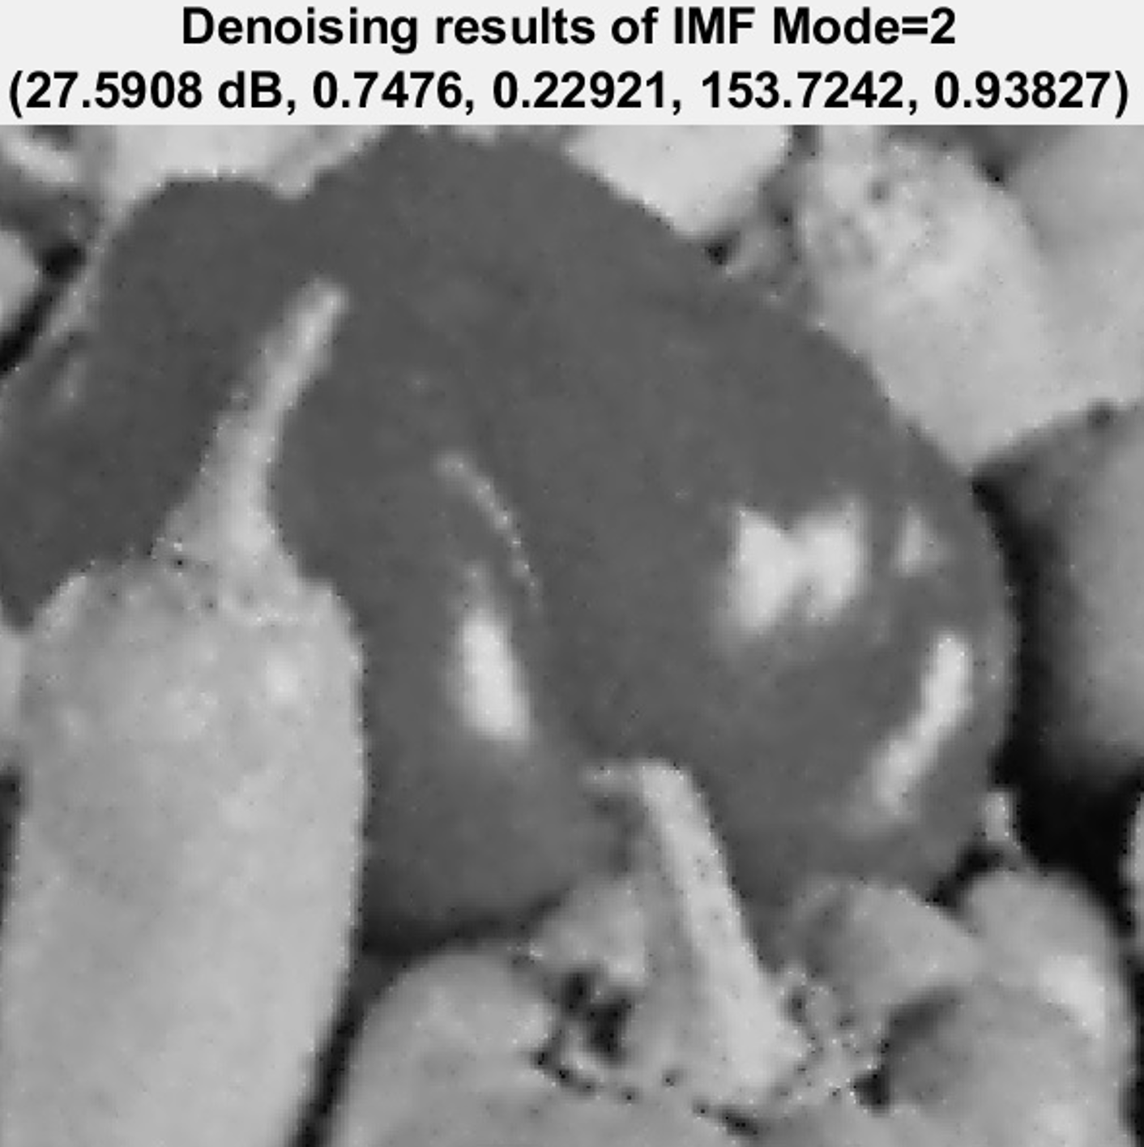
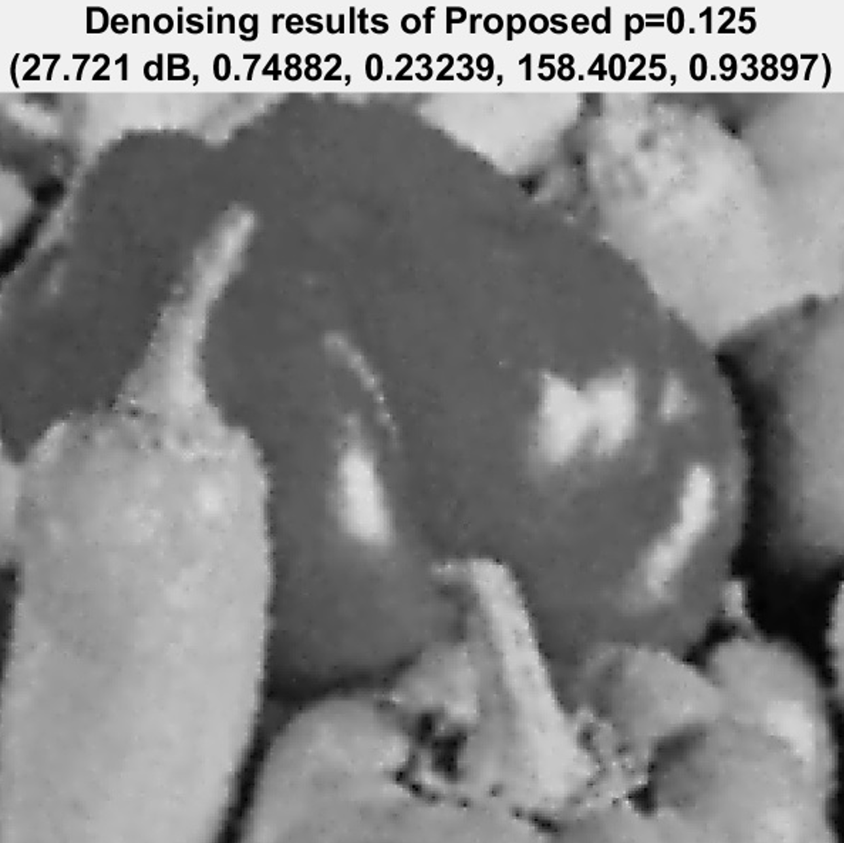





Experimental Results & Discussion

Slide 8
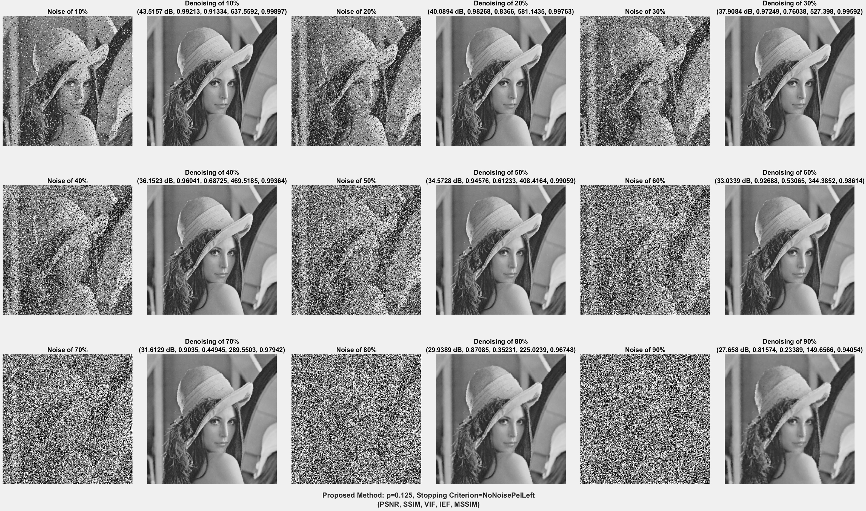
Experimental Results & Discussion

Slide 9
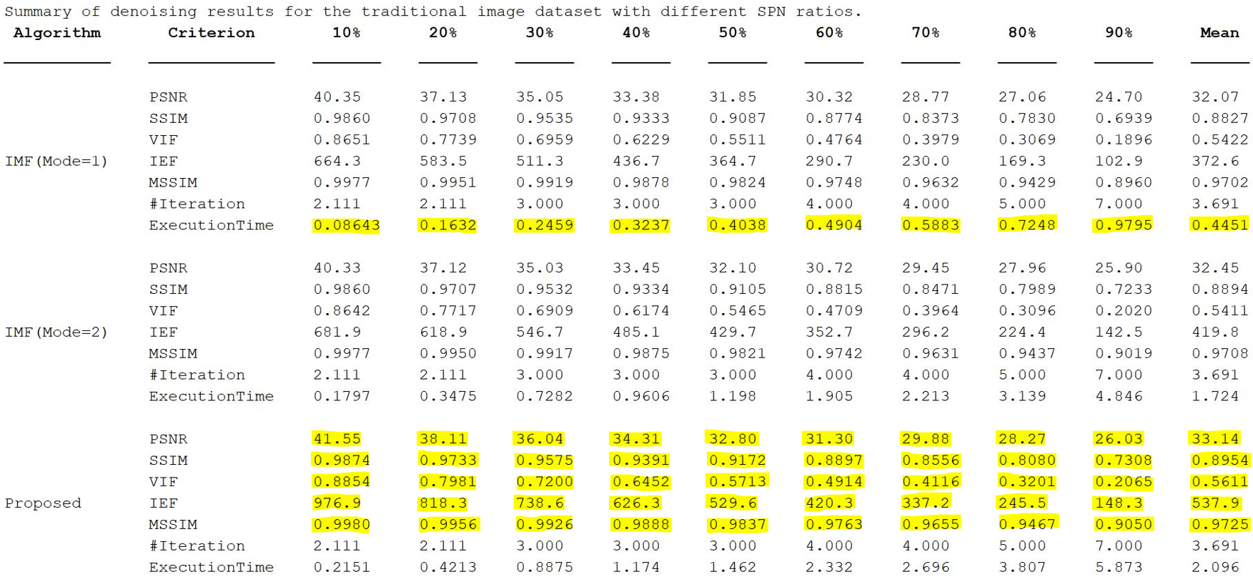
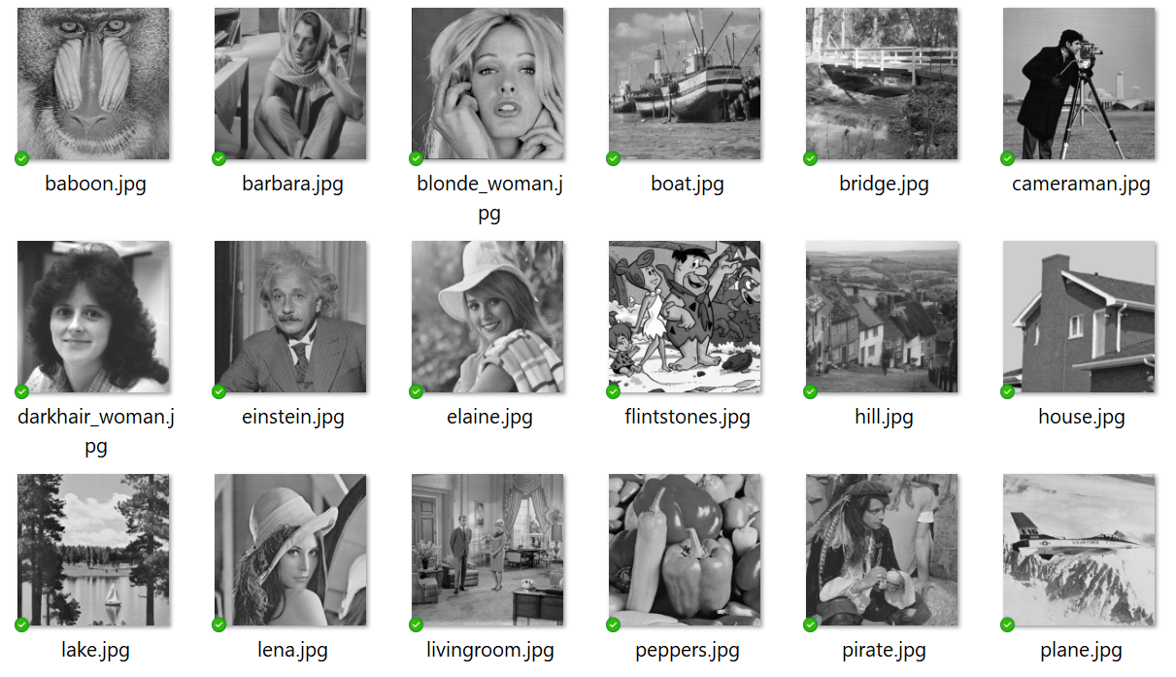
Experimental Results & Discussion
Traditional dataset
18 images
(512x512 pixels)

Slide 10
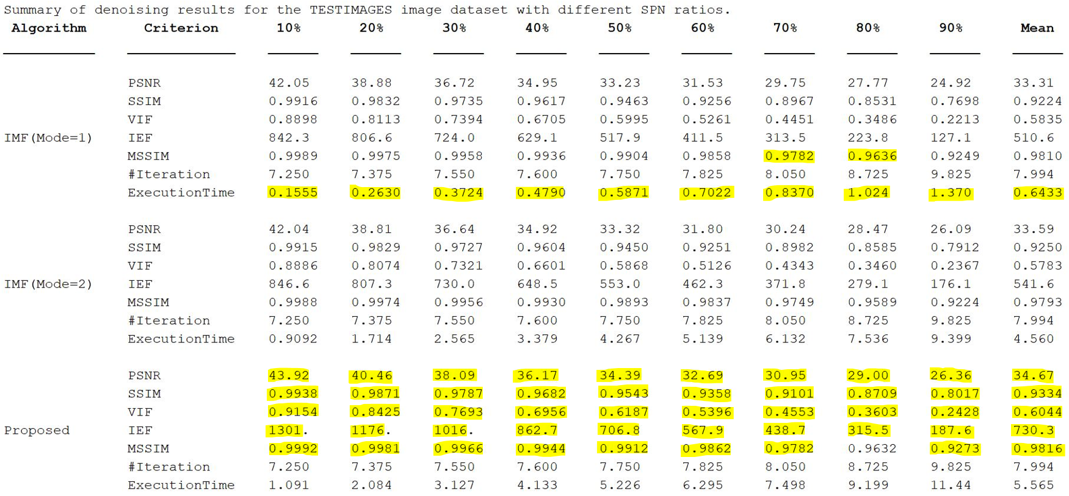
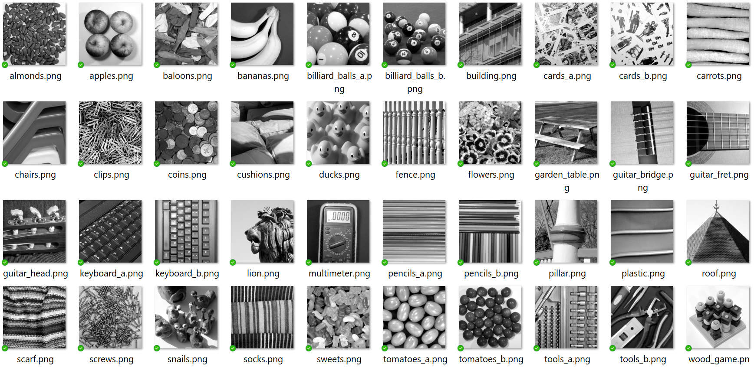
Experimental Results & Discussion
TESTIMAGES dataset
40 images
(600x600 pixels)

Slide 11
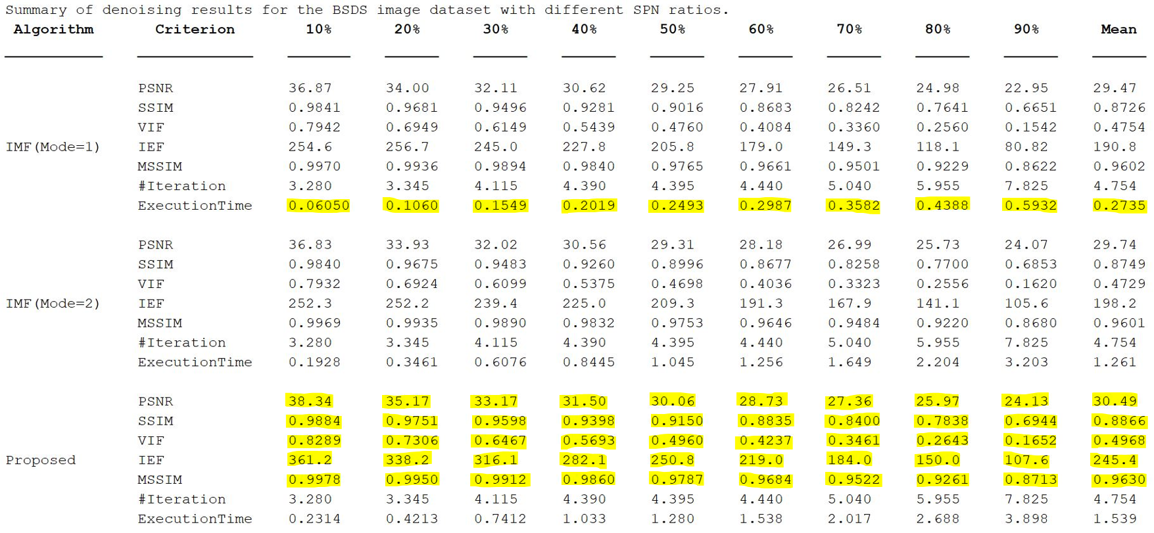
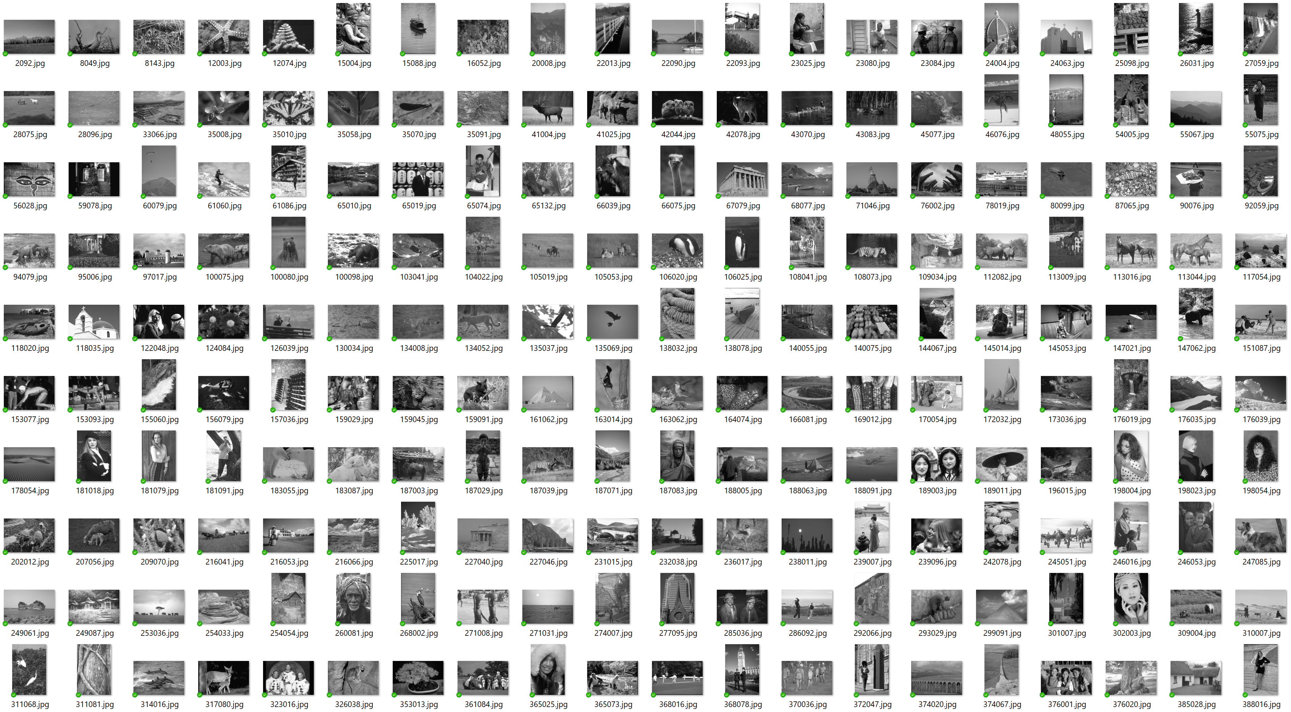
Experimental Results & Discussion
BSDS dataset
200 images
(321x481 or 481x321 pixels)

Slide 12
Conclusion
This project studied the IMF algorithm, reproduced the results with the same settings, and developed an improved version of IMF by introducing the Minkowski–weighted to the constrained mean
IMF (Mode=1) performs better than IMF (Mode=2) in most of low-density SPN, looks sharper in object details even it has the artifacts in high-density SPN, and a lot lower execution times, we can’t confidently conclude that IMF (Mode=2) outperforms IMF (Mode=1)
The proposed IMWMF algorithm can outperform the IMF (Mode=1) and IMF (Mode=2) in almost all cases in the quality assessment metrics sense, but it has more computational complexity (even it’s converged with in the same number of iterations), IMF (Mode=1) is far better execution time than our IMWMF, but IMWMF is comparable to IMF (Mode=2), So, it’s acceptable
There is not much difference between IMWMF and IMF (Mode=2) in the visual quality (but still noticeable that our improved method is better)

Slide 13
References
U. Erkan, D. N. H. Thanh, L. M. Hieu, and S. Engínoğlu, “An Iterative Mean Filter for Image Denoising,” in IEEE Access, vol. 7, pp. 167847–167859, 2019.
M. Yildirim, “Analog circuit implementation based on median filter for salt and pepper noise reduction in image,” Analog Integr. Circuits Signal Process, vol. 107(1), pp. 195–202, 2021.
H. Hwang and R.A. Haddad, “Adaptive median filters: New algorithms and results,” IEEE Trans. Image Process, vol. 4(4), pp. 499–502, 1995.
R.H. Chan, C.-W. Ho, and M. Nikolova, “Salt-and-pepper noise removal by median-type noise detectors and detail preserving regularization,” IEEE Trans. Image Process, vol. 14(10), pp. 1479–1485, 2005.
Y. Dong and S. Xu, “A new directional weighted median filter for removal of random-valued impulse noise,” IEEE Signal Process Lett, vol. 14(3), pp. 193–196, 2007.
U. Erkan, D.N.H. Thanh, S. Engínoğlu, and S. Memis, “Improved adaptive weighted mean filter for salt-and-pepper noise removal,” in Int. Conf. on Electrical, Communication, and Computer Engineering, Istanbul, Turkey, 2020.
L.I. Rudin, S. Osher, and E. Fatemi, “Nonlinear total variation based noise removal algorithms,” Phys. D, vol. 60(1–4), pp. 259–268, 1992.
S. Osher, M. Burger, D. Goldfarb, J. Xu, and W. Yin, “An iterative regularization method for total variation-based image restoration,” SIAM J. Multiscale Model. Simul, vol. 4(2), pp. 460–489, 2005.
D.N.H. Thanh, N.N. Hien, and S. Prasath, “Adaptive total variation L1 regularization for salt and pepper image denoising,” Optik, vol. 208, 163677, 2020.
B. Fu, X. Zhao, Y. Li, X. Wang, and Y. Ren, “A convolutional neural networks denoising approach for salt and pepper noise,” Multimed. Tools Appl, vol. 78(21), pp. 30707–30721, 2018.
G. Li, X. Xu, M. Zhang, and Q. Liu, “Densely connected network for impulse noise removal,” Pattern Anal. Appl, vol. 23(5), pp. 1263–1275, 2020.
C.T. Lu, H.J. Hsu, and L.L. Wang, “Image denoising using dlnn to recognize the direction of pixel variation,” Signal Image Video Process, vol. 10, pp. 1–10, 2021.
J. S. Lim, Two-Dimensional Signal and Image Processing. Englewood Cliffs, NJ, USA: Prentice-Hall, 1990.
P. Zhang and F. Li, “A New Adaptive Weighted Mean Filter for Removing Salt-and-Pepper Noise,” in IEEE Signal Processing Letters, vol. 21, no. 10, pp. 1280–1283, 2014.
M. J. Azur, E. A. Stuart, C. Frangakis, and P. J. Leaf, “Multiple imputation by chained equations: what is it and how does it work?,” International journal of methods in psychiatric research, vol. 20(1), pp. 40–49, 2011.
D. J. Stekhoven and P. Bühlmann, “MissForest–nonparametric missing value imputation for mixed-type data,” Bioinformatics, vol. 28(1), pp. 112–118, 2012.
O. Troyanskaya, M. Cantor, G. Sherlock, P. Brown, T. Hastie, R. Tibshirani, D. Botstein, and R. Altman, “Missing value estimation methods for DNA microarrays,” Bioinformatics vol. 17(6), pp. 520–525, 2001.
S.H. Cha, “Comprehensive survey on distance/similarity measures between probability density functions,” International Journal of Mathematical Models and Methods in Applied Sciences, vol. 1(4), pp. 300–307, 2007.
Z. Wang, A. C. Bovik, H. R. Sheikh, and E. P. Simoncelli, “Image quality assessment: From error visibility to structural similarity,” IEEE Trans. Image Process., vol. 13(4), pp. 600–612, 2004.
H. R. Sheikh and A. C. Bovik, “Image information and visual quality,” IEEE Trans. Image Process., vol. 15(2), pp. 430–444, 2006.
I. Djurović, “Combination of the adaptive Kuwahara and BM3D filters for filtering mixed Gaussian and impulsive noise,” Signal, Image Video Process., vol. 11(4), pp. 753–760, 2017.
Z. Wang, E. P. Simoncelli, and A. C. Bovik, “Multiscale structural similarity for image quality assessment,” in Proc. Conf. Rec. Asilomar Conf. Signals, Syst. Comput., 2003, pp. 1398–1402.
N. Asuni and A. Giachetti, “TESTIMAGES: A large-scale archive for testing visual devices and basic image processing algorithms,” in Proc. Eurograph. Italian Chapter Conf., 2014, pp. 1–3.

Slide 14
Q&A

